Slide 1
Coursera Capstone project
ROHITHKUMAR

Slide 2
Report Content
1. Introduction Section :
⁃ The “business problem” to be solved by this project and who may be interested
2. Data Section:
⁃ Describe Data requirements and Sources needed to solve the problem
3. Methodology section:
⁃ Main component of the report - Execute data processing, describe/discuss any
exploratory data analysis and/or inferential statistical testing performed, and/or
machine learnings used.
4. Results section:
⁃ Discussion of the results and finding of answer
5. Discussion section:
⁃ Discussion of observations noted and any recommendations
6. Conclusion section:
⁃ Answer chosen and conclusions.

Slide 3
2.0 Data Section
2.1 Data Requirements
- Geodata for current residence in Singapore with venues established using Foursquare.
- List of Manhattan (MH) neighborhoods with clustered venues established via Foursquare (as in Course
Lab). https://en.wikipedia.org/wiki/List_of_Manhattan_neighborhoods#Midtown_neighborhoods
- List of subway metro stations in Manhattan with addresses and geo data (lat,long): https://
en.wikipedia.org/wiki/List_of_New_York_City_Subway_stations_in_Manhattan) , (https://www.google.com/
maps/search/manhattan+subway+metro+stations/@40.7837297,-74.1033043,11z/data=!3m1!4b1)
number of beds, area size, monthly rent price and complemented with geo data via Nominatim. http://
www.rentmanhattan.com/index.cfm?page=search&state=results https://www.nestpick.com/search?
city=new-

Slide 4
2.2 Data Sources, Data Processing and Tools used
- Singapore data and map is to be created with use of Nominatim , Foursquare and Folium mapping
- Manhattan neighborhoods were obtained from Wikipedia and organized by Neighborhoods with geodata
via Nominatim for mapping with Folium.
- List of Subway stations was obtained via Wikipedia, NY Transit web site and Google map,
- List of apartments for rent was consolidated from web-scraping real estate sites for MH. The geolocation
(lat,long) data was found with algorithm coding and using Nominatim.
- Folium map was the basis of mapping with various features to consolidate all data in ONE map where
one can visualize all details needed to make a selection of apartment

Slide 5
3.0 Methodology
The Strategy to find the answer:
The strategy is based on mapping the described data in section 2.0, in order to
facilitate the choice of at least two candidate places for rent. The information will be
consolidated in ONE MAP where one can see the details of the apartment, the cluster
of venues in the neighborhood and the relative location from a subway station and
From work place. A measurement tool icon will also be provided. The popups on the
map items will display rent price, location and cluster of venues applicable.

Slide 6
Execution and results.

Slide 7
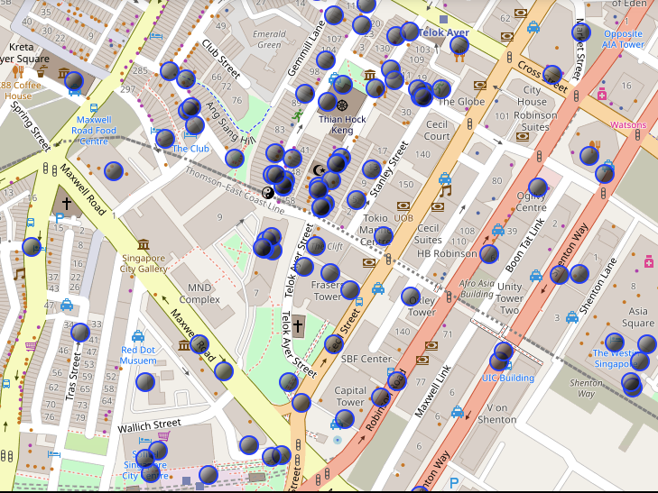
Current residence Neighborhood in Singapore

Slide 8
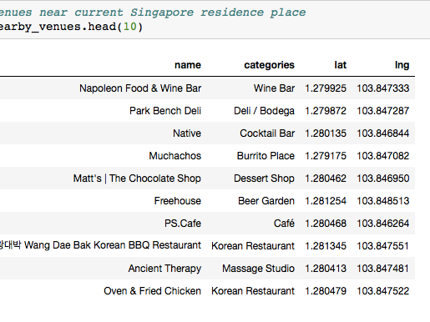
Venues around Neighborhood in

Slide 9
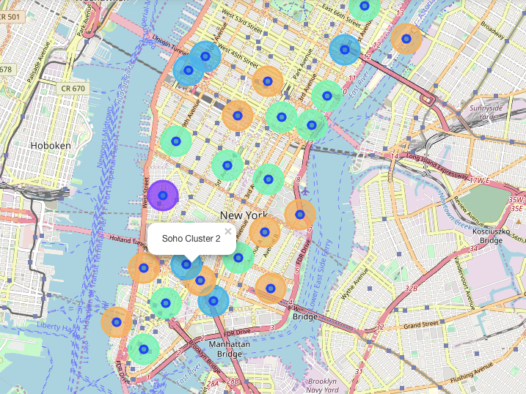
Manhattan Map - Neighborhoods and Cluster of Venues

Slide 10
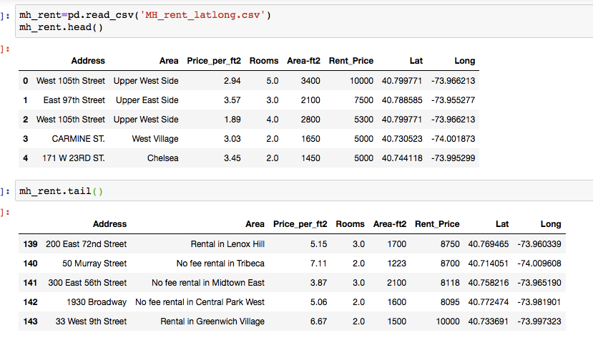

Slide 11
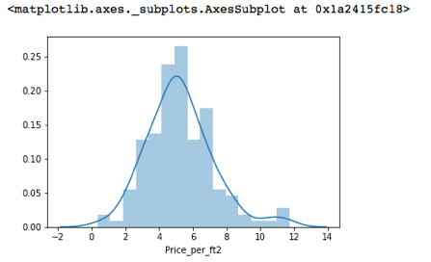
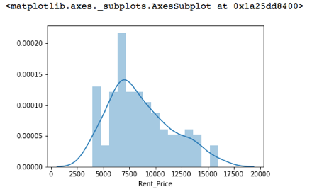
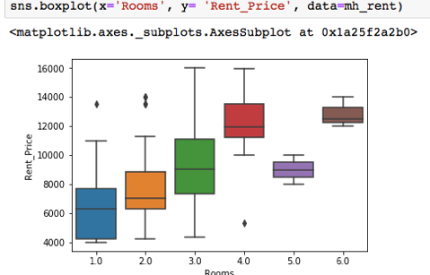
Rental Price Statistics MH Apartments
Budget US7000/month is around the mean

Slide 12
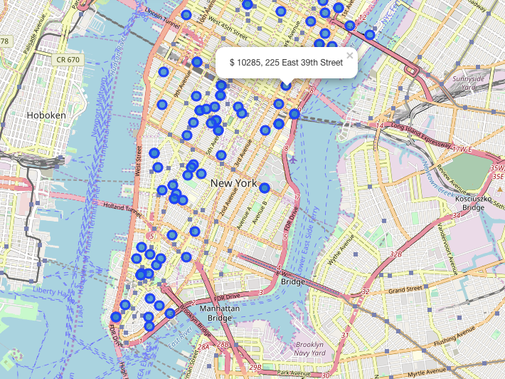
Apartments for Rent in MH

Slide 13
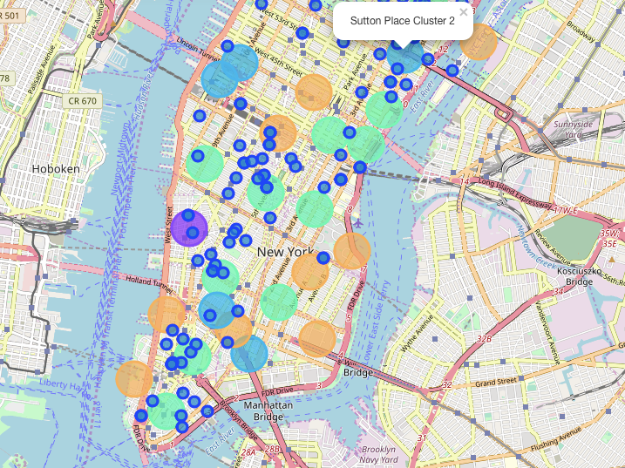
MH apts for rent with venue clusters

Slide 14
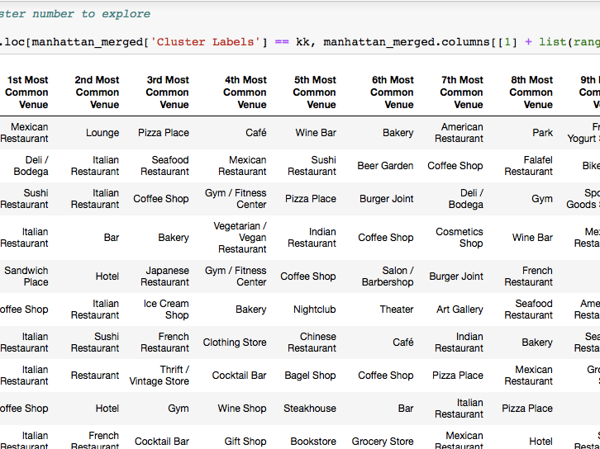
Venues of cluster 3

Slide 15
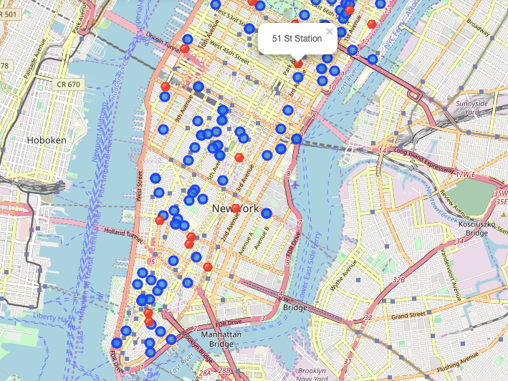
Apts for rent (blue) and subway stations (red)

Slide 16
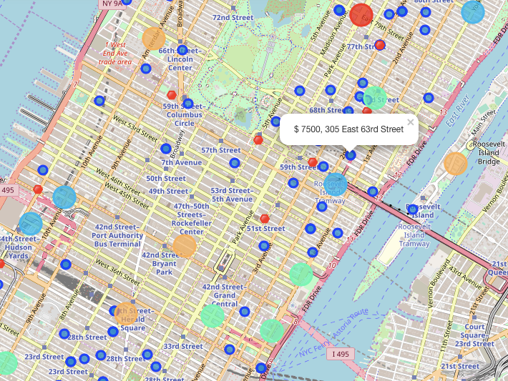
Selected Apartment

Slide 17
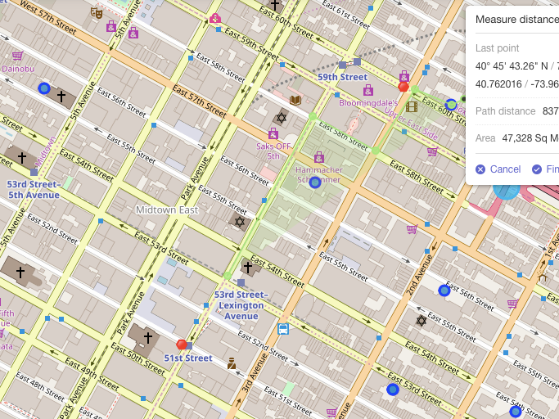
Walking Distance from home to work

Slide 18
6.0 Conclusions
• I feel rewarded with the efforts, time and money spent. I
believe this course with all the topics covered is well worthy
of appreciation.
• This project has shown me a practical application to resolve
a real situation that has impacting personal and financial
impact using Data Science tools.
• The mapping with Folium is a very powerful technique to
consolidate information and make the analysis and decision
thoroughly and with confidence. I would recommend for
use in similar situations.
• One must keep abreast of new tools for DS that continue
to appear for application in several business fields

